Slide 1
System Calls

Slide 2
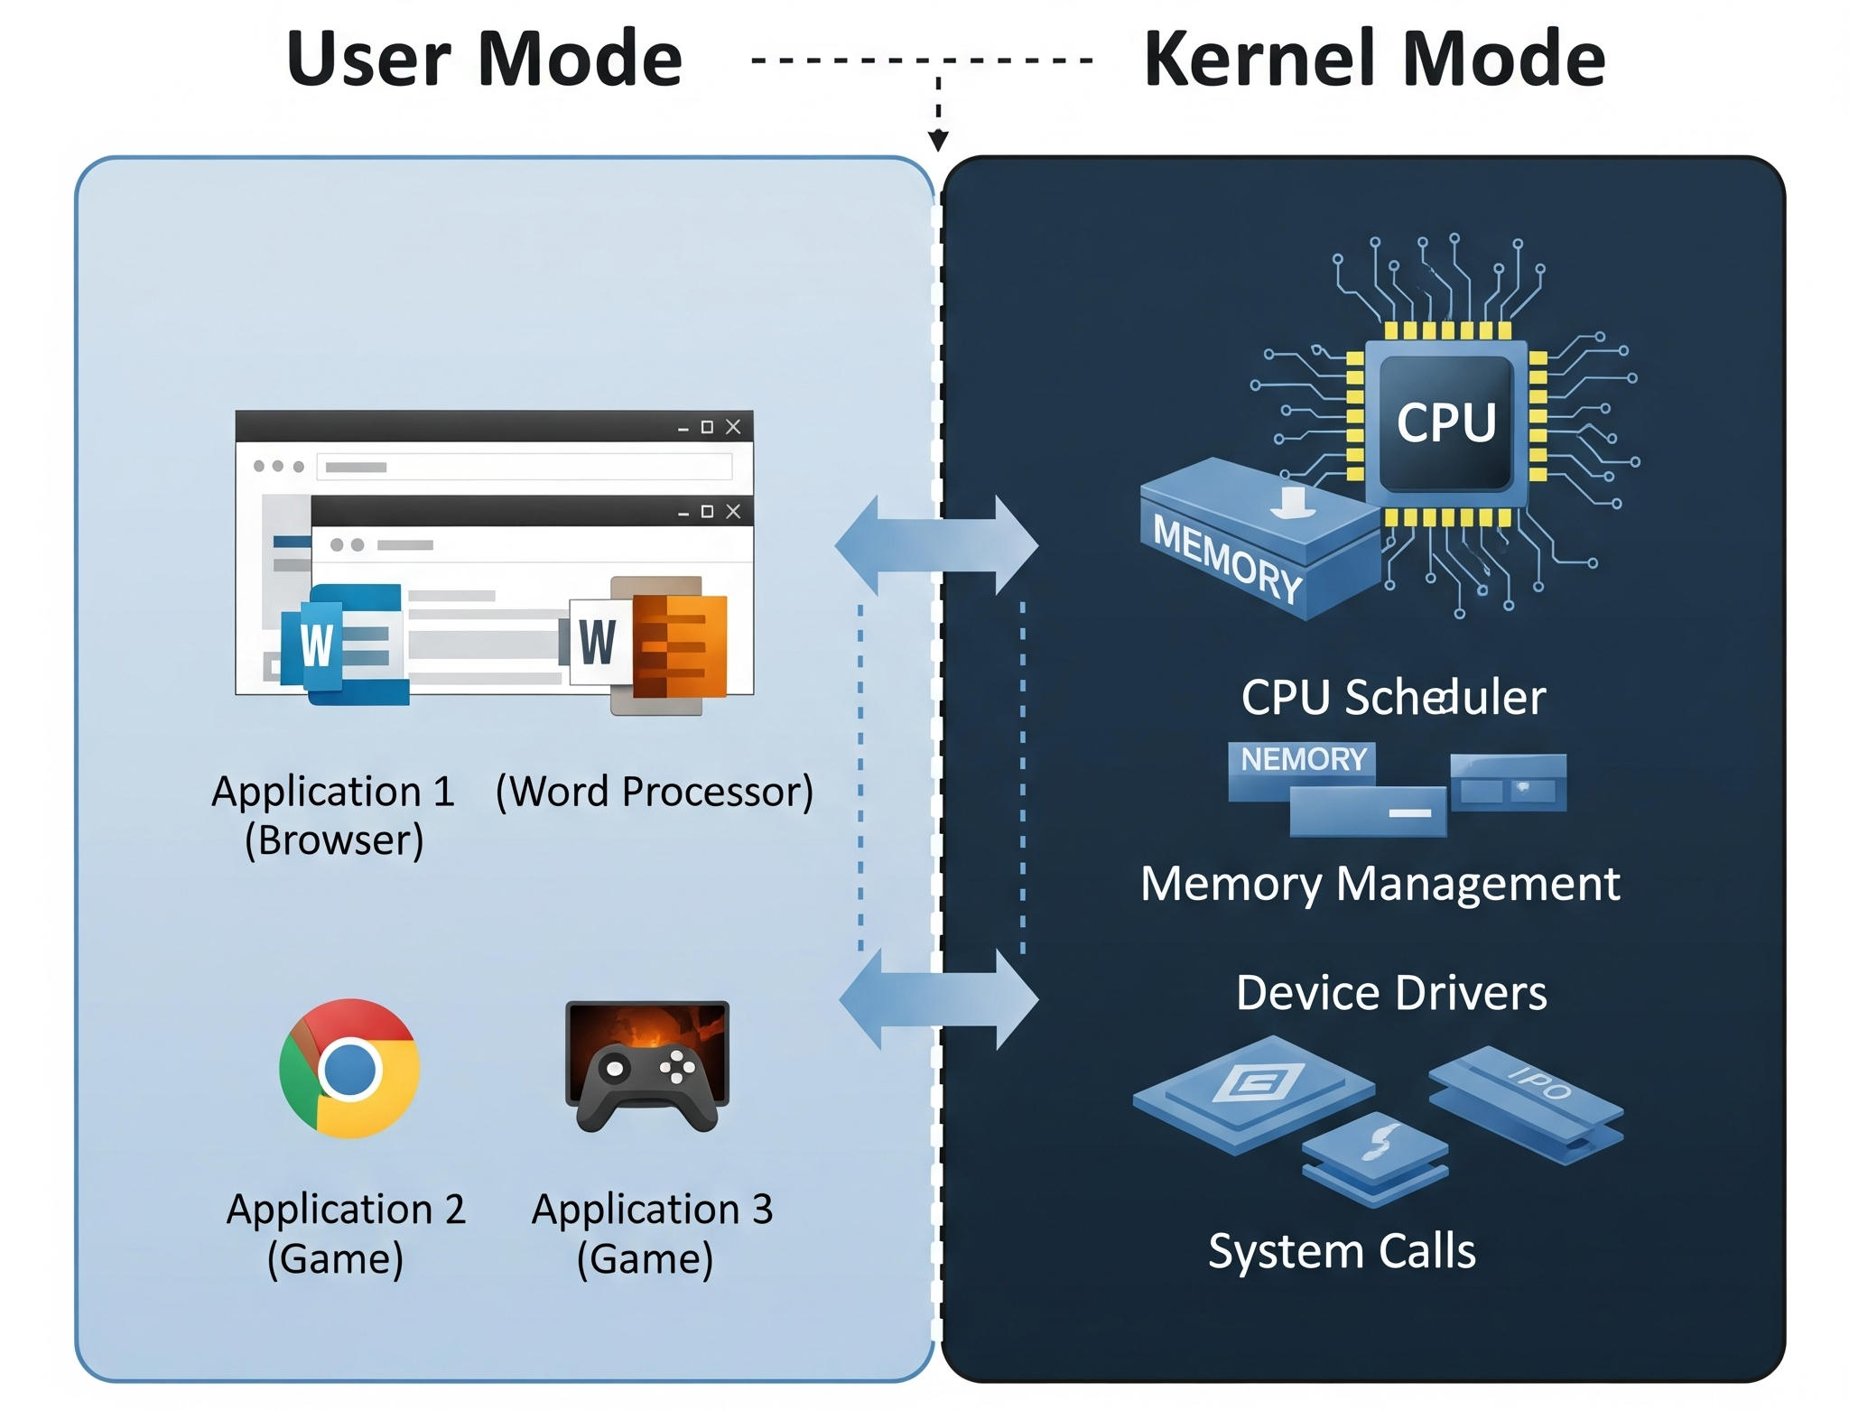
Operating Systems Modes

Slide 3
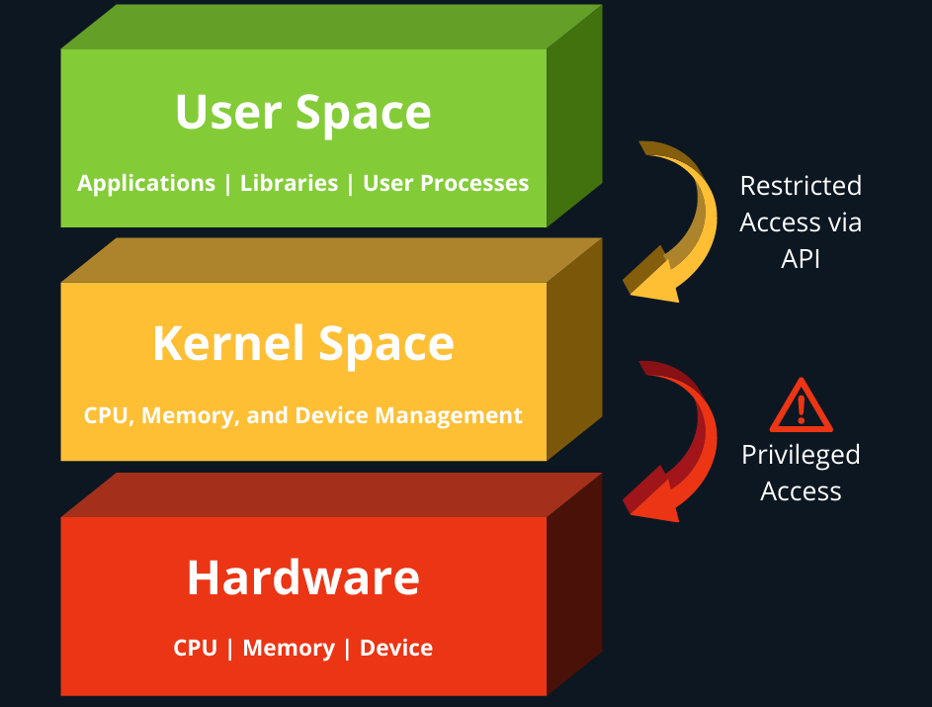
Privileged Access
System calls provide the interface between a process and the operating system

Slide 4
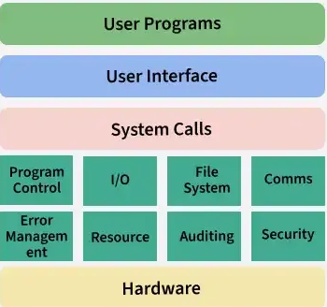
System Calls- Benefits
Ensures that hardware resources are isolated from user space processes.
Prevents direct access to the kernel and hardware
Allows application code to run across different hardware architecture.

Slide 5
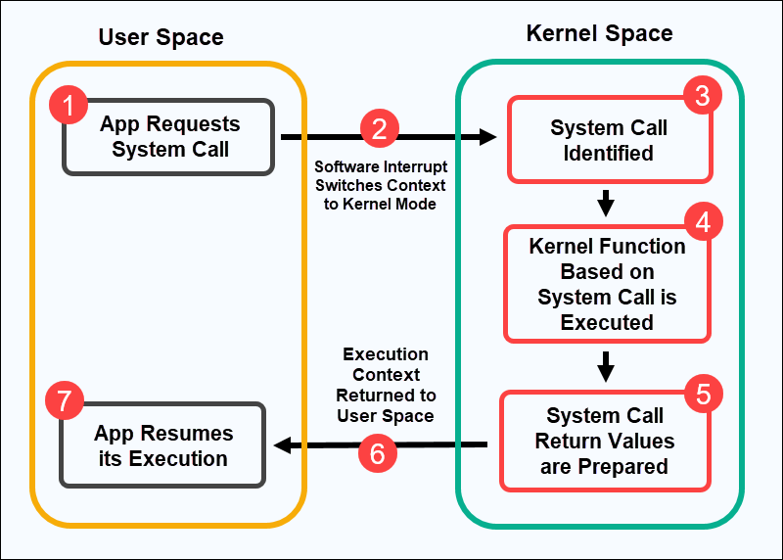
Working

Slide 6
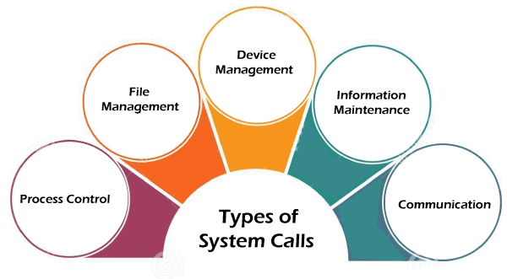
Types of System Calls

Slide 7
Unix System Call | Windows | Description
fork() | CreateProcess() | Creating a New Process
exit() | ExitProcess() | Terminate the current process.
open() | CreateFile() | Open/create a file or device
read() | ReadFile() | Read data from a file or input device.
write() | WriteFile() | Write data to a file or output device.
socket() | socket() | Creates socket for communication
chmod() or umask() | SetFileAttributes() or SetSecurityInfo() | Change the permissions/mode of a file.

